Slide 1

VeCan or VeCan’t
Finding Vegan/Vegetarian Friendly Restaurants
Nabor Reyna

Slide 2
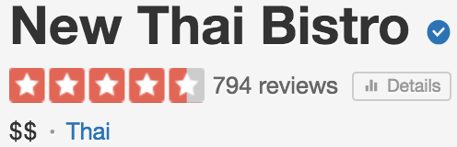
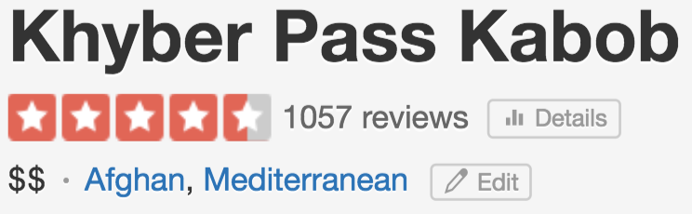
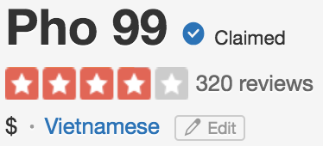
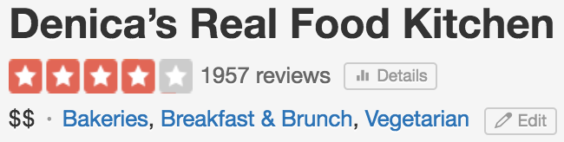
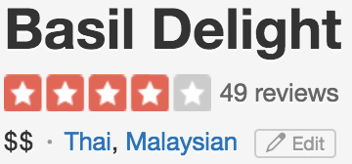
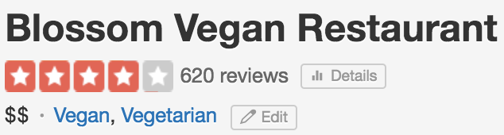

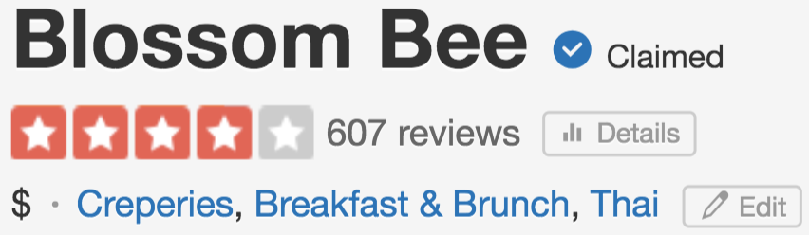
What’s for dinner?
Commence the endless search through restaurant reviews

Slide 3

My Challenge
Given: Yelp restaurant review data;
Can I find a Vegan/Vegetarian friendly dining option?

Slide 4

Data
Yelp Challenge Data Set
DB Access to 5 million reviews
Extracted ~1 Million rows for project
5 cuisines (US only)
Tag – Vegan/Vegetarian reviews
About 20% of the data

Slide 5

Data Distributions
Veggie Friendly by Cuisine

Slide 6
Models
Naïve Bayes
Random Forest

Slide 7
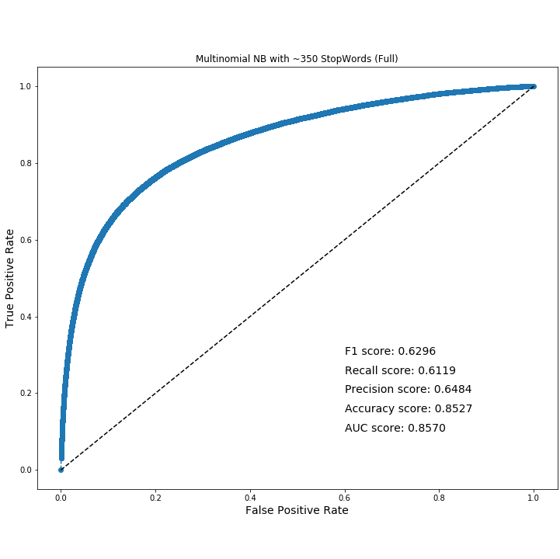
Naïve Bayes
Recall 61%
F1 0.62
Notes:
MNB_357StWds_full_countV.png

Slide 8
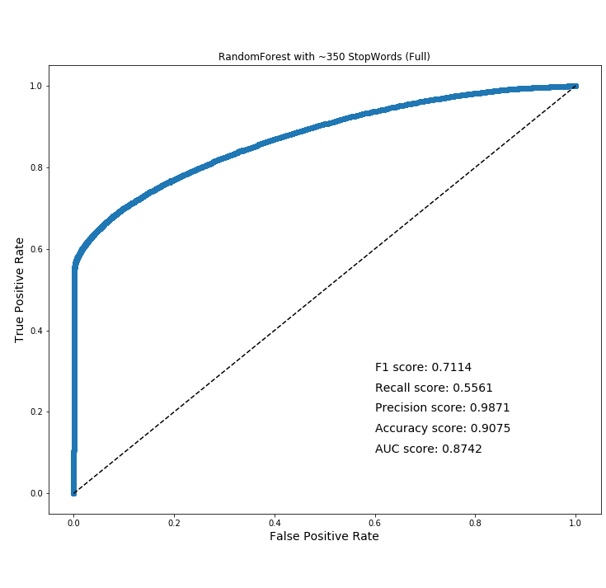
Random Forest
Recall 55%
F1 – 0.71
Notes:
MNB_357StWds_full_countV.png

Slide 9
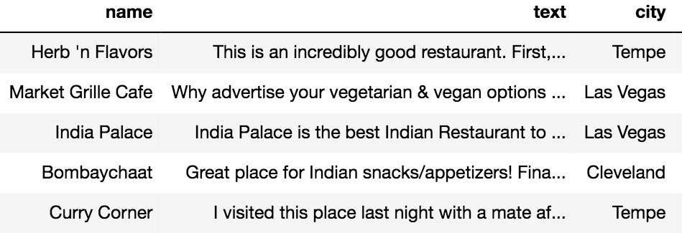
False Positive
False Positives
Reviews NOT tagged 'Veggie Friendly’
but PREDICTED that they are.
Able to find untagged places as Veggie-Friendly.

Slide 10
False Negatives
Reviews tagged as 'Veggie Friendly’
but NOT PREDICTED that they are.
Low predictive capability:
Possibly because reviews here don't speak about the Veggie Friendly food, but more so about the establishment.
Sports lovers... this is your place to be! Not the usual Vegas crazy place but pretty for Sunday football! …
Hip joint, full of cool kids and good beers, I wouldn't recommend to anyone who wants a quiet drink or a chill setting for a square - but if you're young and wearing plaid with an appreciation for canned American pilsner, then right on.
Enjoyed the burger very much. Chicken nuggets were GREASY and their drive thru was frustrating. Bad intercom. A little overpriced, but convenient for the meatless hunger. I'll give 'em another try.

Slide 11


Future Directions
Pivot my challenge:
Create a corpus of with ALL reviews for a business and predict on that
Try models with more cuisines
Refresh dataset (new set released)
Go eat at some new places!

Slide 13

